Slide 1

CI - CD

Slide 2
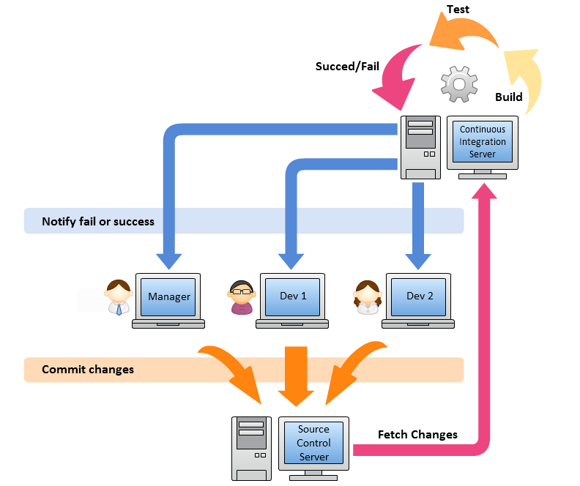
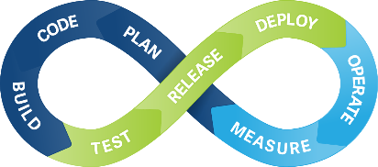
Continuous
Integration

Slide 3
Jenkins, JaCoCo Integration With Maven
Installing JaCoCo Jenkins plugin (https://wiki.jenkins-ci.org/display/JENKINS/JaCoCo+Plugin)
Get coverage data as part of your build
<plugin>
<groupId>org.jacoco</groupId>
<artifactId>jacoco-maven-plugin</artifactId>
<version>0.5.5.201112152213</version>
<configuration>
<destFile>${basedir}/target/coverage-reports/jacoco-unit.exec</destFile>
<dataFile>${basedir}/target/coverage-reports/jacoco-unit.exec</dataFile>
</configuration>
<executions>
<execution>
<id>jacoco-initialize</id>
<goals>
<goal>prepare-agent</goal>
</goals>
</execution>
<execution>
<id>jacoco-site</id>
<phase>package</phase>
<goals>
<goal>report</goal>
</goals>
</execution>
</executions>
</plugin>
Run "mvn clean package" & you would get the jacoco xml, exec files under target dir
Publishing the Jacoco report directly on Jenkins
Edit Job -> Configure -> Post-build Actions -> Add post-build action -> Record JaCoCo coverage report

Slide 4
Jenkins, JaCoCo, and SonarQube Integration With Maven
Installing SonarQube Plugin
(https://wiki.jenkins-ci.org/display/JENKINS/SonarQube+plugin)
Manage Jenkins -> Configure System -> SonarQube servers -> Add SonarQube
Manage Jenkins -> Global Tool Configuration -> SonarQube Scanner -> Path where scanner home dir
Edit Job -> Build Section -> Add new Build step -> Execute SonarQube Scanner -> Analysis properties
# Mandatory Medata required
sonar.projectKey=WEZVA
sonar.projectName=SonarDemo
sonar.projectVersion=1.0
# path to the src dir of the maven project
sonar.sources=src
sonar.java.binaries=target\\classes
sonar.jacoco.reportPath=target\\coverage-reports\\jacoco-unit.exec
Add Artifactory server
Test connection
Build application
Running tests with Jacoco test coverage report
Running SonarQube analysis
Pushing test result, test coverage report and SonarQube analysis report to SonarQube Server

Slide 5

Not every change is a release
Build software so that it can be rapidly & safely deployed to production by delivering every change to a production-like environment
Ensuring business applications and services function as expected through rigorous automated testing
Manual trigger of deployment when business is ready
Every change is proven to be deployable at any time
Continuous Delivery = Continuous Integration +
fully automated test suite

Slide 6







Continuous Integration
Build
UnitTest
Stage
Continuous Delivery
Build
UnitTest
Stage
Acceptance
Test
Deploy
Continuous Deployment
Build
UnitTest
Stage
Acceptance
Test
Deploy

Slide 7
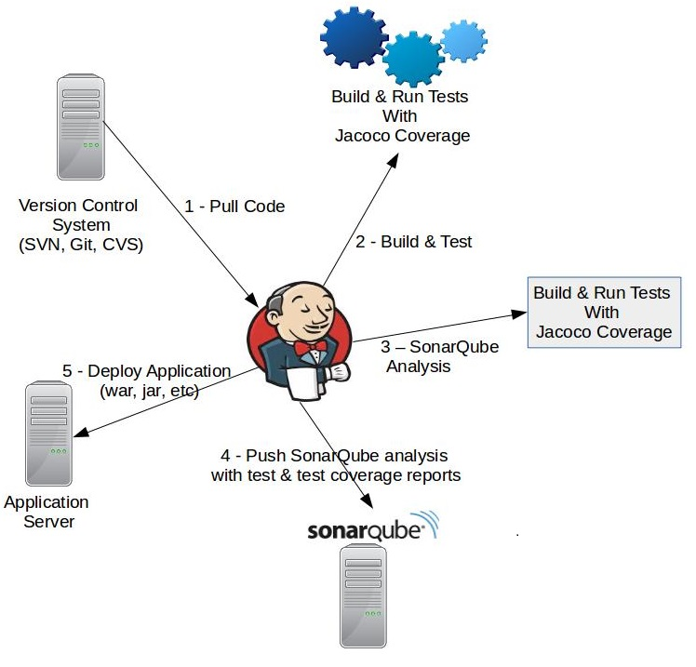

Slide 8
Install Artifactory
Install Docker CE (Community Edition)
Set up the Docker CE repository on CentOS:
% sudo yum install -y yum-utils
% sudo yum-config-manager --add-repo https://download.docker.com/linux/centos/docker-ce.repo
Install the latest version of Docker CE on CentOS:
% sudo yum -y install docker-ce
Start Docker:
% sudo systemctl start docker
Installing Artifactory on Docker
Pulling the Artifactory Docker Image
% docker pull docker.bintray.io/jfrog/artifactory-oss:latest
Running an Artifactory Container
% docker run --name artifactory-5.0.0 -d -v /var/opt/jfrog/artifactory:/var/opt/jfrog/artifactory -p 8081:8081 docker.bintray.io/jfrog/artifactory-oss:latest
Notes:
http://machine:8081/artifactory -> admin/password

Slide 9
Jenkins Artifactory Integration
First step to Install Artifactory using Docker
Install Artifactory Plugin
(https://wiki.jenkins-ci.org/display/JENKINS/Artifactory+Plugin)
Jenkins -> Manage Jenkins -> Configure System -> Artifactory
Remove the "Enable Push to Bintray“
Add Artifactory server
Test connection
Job -> configuration -> Build Environment section -> Maven3-Artifactory Integration
Artifactory Configuration -> Input the Artifactory server name -> Refresh repositories to take the default repository
Enable "Deploy artifacts to Artifactory“
Enable "Capture and publish build info“
Under Build section -> Invoke Artifactory Maven 3
Notes:
First step to Install Artifactory using Docker

Slide 10

Deployment
Create a Web App project using Maven
mvn archetype:generate -DgroupId=demo -DartifactId=samplewar -DarchetypeArtifactId=maven-archetype-webapp -DinteractiveMode=false
Create a deliverable Image using Dockerfile
FROM jboss/wildfly
ADD target/samplewar.war /opt/jboss/wildfly/standalone/deployments/
RUN /opt/jboss/wildfly/bin/add-user.sh admin admin --silent
CMD ["/opt/jboss/wildfly/bin/standalone.sh", "-b", "0.0.0.0", "-bmanagement", "0.0.0.0"]
Run container
docker run --name myjboss -d -p 9990:9990 -p 8080:8080 myjboss/wildfly
Accessing your Web Application
http://<machine>:8080/<projectname>

Slide 11
Jenkins - Server Maintenance
URL Options
http://localhost:8080/jenkins/exit − shutdown jenkins
http://localhost:8080/jenkins/restart − restart jenkins
http://localhost:8080/jenkins/reload − to reload the configuration
Backup Jenkins Home
Jenkins Home directory is nothing but the location on your drive where Jenkins stores all information for the jobs, builds etc
Backup Plugin

Slide 12
Jenkins Best Practices
Always secure Jenkins
In larger systems, don't build on the master
Backup Jenkins Home regularly
Integrate tightly with your issue tracking system, like JIRA or bugzilla, to reduce the need for maintaining a Change Log
Set up Jenkins on the partition that has the most free disk-space
Archive unused jobs before removing them
Avoid scheduling all jobs to start at the same time

Slide 13
Popular Plugins
Parameterized plugin
Pre SCM Buildstep plugin
Job configuration History Plugin
Build failure analyzer
Nested View plugin
Matrix Authorization strategy plugin
Build-timeout plugin
Throttle concurrent builds plugin
Build pipeline plugin

Slide 14
Jenkins - Pipeline
Jenkins Pipeline is a suite of plugins which supports implementing and integrating continuous delivery pipelines into Jenkins. (https://jenkins.io/doc/book/pipeline/syntax)
pipeline {
agent {
node {
label "testgroup"
customWorkspace "c:/wezva/jenkins/workspace/PIPELINE"
}
}
triggers {
cron('* * * * *')
}
stages {
stage('Stage1') {
steps {
echo 'Running steps for Stage I'
}
}
stage('Stage2') {
steps {
echo 'Running steps for Stage II'
}
}
}
post {
always {
echo 'I will always say Hello again!'
}
}
}

Slide 15

Code Review: An Agile Process
Why are code reviews valuable?
Engineers like (and need) to take vacation
New employees want to be productive quickly
Discover Bugs
Team culture evolves engaging engineers
The general process for using Review Board for pre-commit review is as follows:
Make a change to your local source tree.
Create a review request for your new change.
Publish the review request and wait for your reviewers to see it.
Wait for feedback from the reviewers.
If reviewers have requested changes:
Update the code in your tree and generate a new diff
Upload the new diff, specify the changes in the Change Description box, and publish.
Jump back to step 4
If reviewers say “Ship It!”
Submit your change to the repository
Click Close
Tools : Reviewboard, Gerrit, Gitlab

Slide 16
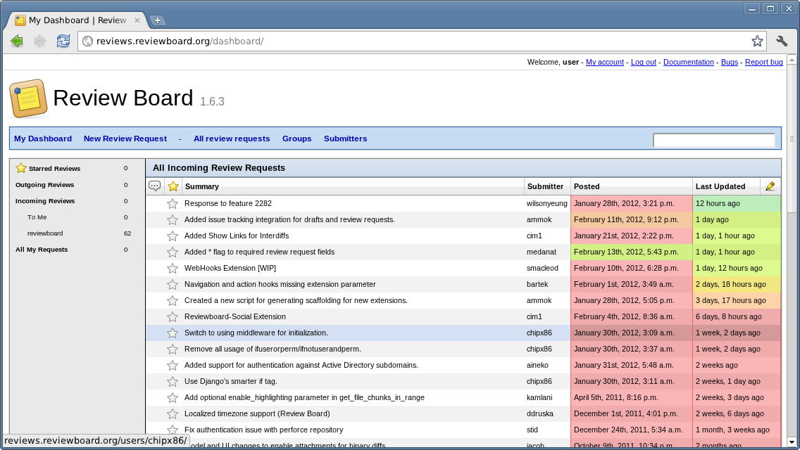

Slide 17
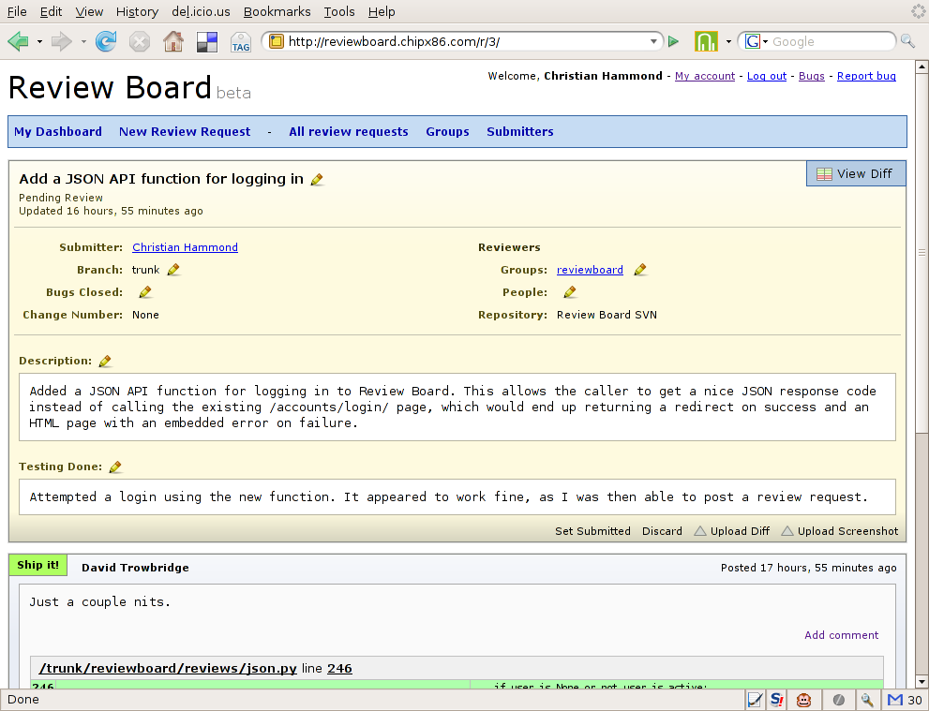

Slide 18
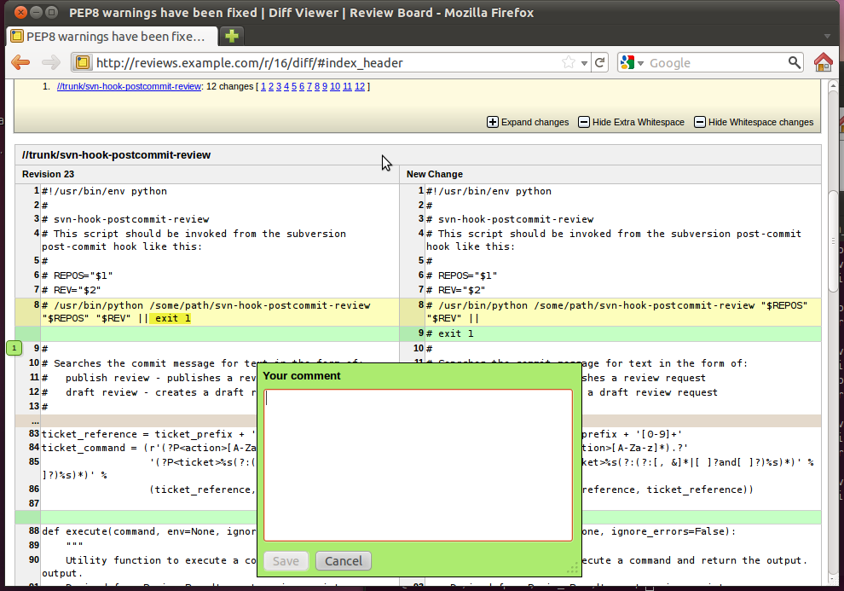

Slide 19

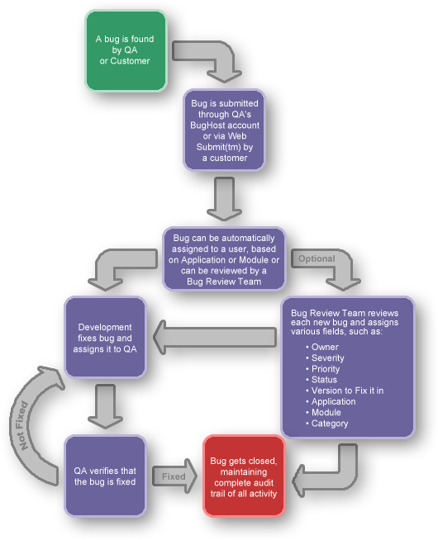
Defect Tracking
A process of finding defects in the application under test or product by testing or recording feedback from customers and making new versions of the product that fix the defects or the clients feedback.
Defect Tracking Tools : Bugzilla, JIRA, Mantis BT, HP-ALM, IBM Rational Clearquest

Slide 20
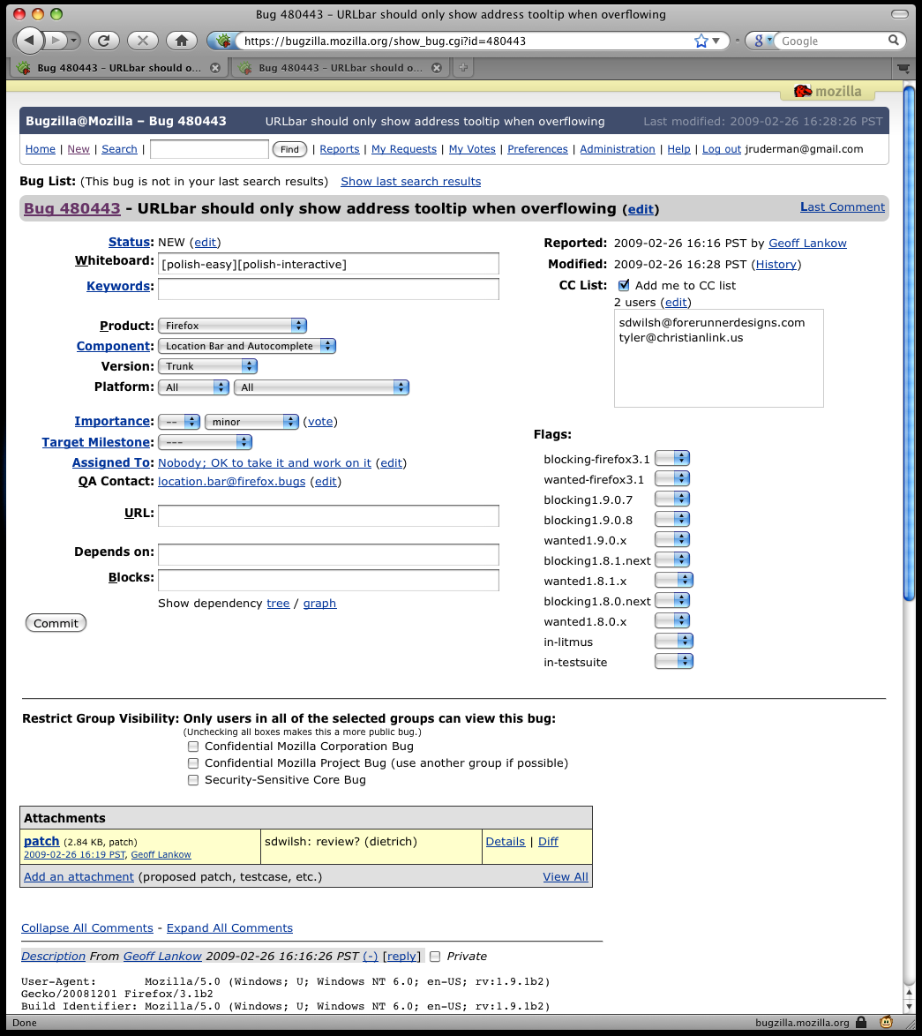

Slide 21
